Slide 1
Employee Data Analysis using Excel
STUDENT NAME: MANISHA R
REGISTER NO:312210016
DEPARTMENT:B COM GENERAL
COLLEGE:VALLIAMMAL COLLEGE FOR WOMEN

Slide 2
PROJECT TITLE
Employee Performance Analysis using Excel

Slide 3


AGENDA
Problem Statement
Project Overview
End Users
Our Solution and Proposition
Dataset Description
Modelling Approach
Results and Discussion
Conclusion
3/21/2024 Annual Review

Slide 4

PROBLEM STATEMENT
It analyse the factors influencing employee salary in the business
development department.consider variables such as employee
gender,employment type (permanent,temporary fixed term ,or remote).and location.identify and trends or patterns and recommended strategies ton optimize salary structures while maintaining fairness and equity across the department

Slide 5

PROJECT OVERVIEW
.
The project aims to analyse the salary distribution within the business development department,focusing on factors such as gender,employment type,and location.by examining trends and identifying potential disparities,the project seeks to ensure fair and equitable compensation practices.key tasks include data cleaning,exploratoryanalysis,and visualization of findings.

Slide 6

WHO ARE THE END USERS?
The end users in the spreadsheet are
individuals working in business development
roles. The spreadsheet includes details such
as their names,gender,employee start
dates,employment type
(eg.permanent,temporary,fixed term),and
location (which could be remote or specific
cities).The chart in the image appears to show
salary tends or distributions.

Slide 7

OUR SOLUTION AND ITS VALUE PROPOSITION
0ur solution efficiently organizes and
visualizes key employee data within
the business
Development department.By
consolidating information such as
salary,employment type,and
location,the solution enables
streamlined HR operations,effective
workforce planning,and compliance
management.

Slide 8
Dataset Description
Employess in the business development department.it
includes fields such as employee
ID,Name,gender,salary,start date,employment
type(e.g.,permanent,temporary),and location(city or
remote).The data is visually represented in a chart,likely
showing salary trends or distributions,providing a quick
overview of compensation patterns across the department

Slide 9
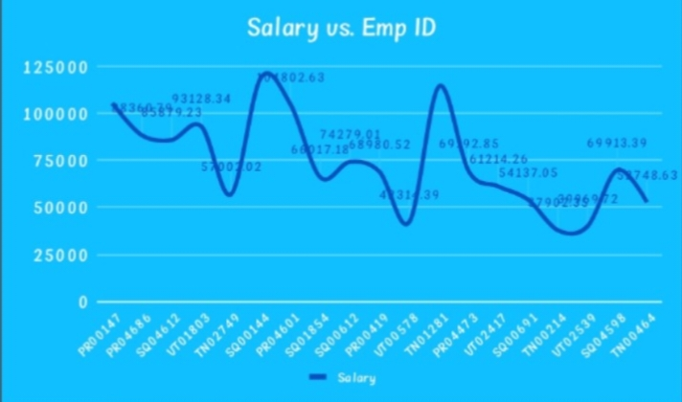

THE "WOW" IN OUR SOLUTION
3/21/2024 Annual Review
9

Slide 10
MODELLING
The model helps to understand the influence of
each factor on salary,providing valuable insights
into the determinants of employee compensation
within the organisation.The basic analysis serves
as starting point for deeper exploration and
decision making
10

Slide 11
RESULTS
11

Slide 12
conclusion
The data reflects a consistent increase in salaries
over time for individuals in the business
development sector,with various employment types
and global locations. The chart highlights a steady
growth pattern in salary distribution across the
dataset

